Slide 1

INTRODUCTION
Developing RESTfull APIs with Jersey

Slide 2

COURSE SECTION
SECTION ONE: RESTfull API Concepts
SECTION TWO: Implementation with Jersey

Slide 3
Web Services
Web services are services which are exposed to the internet for programmatic access.

Slide 4
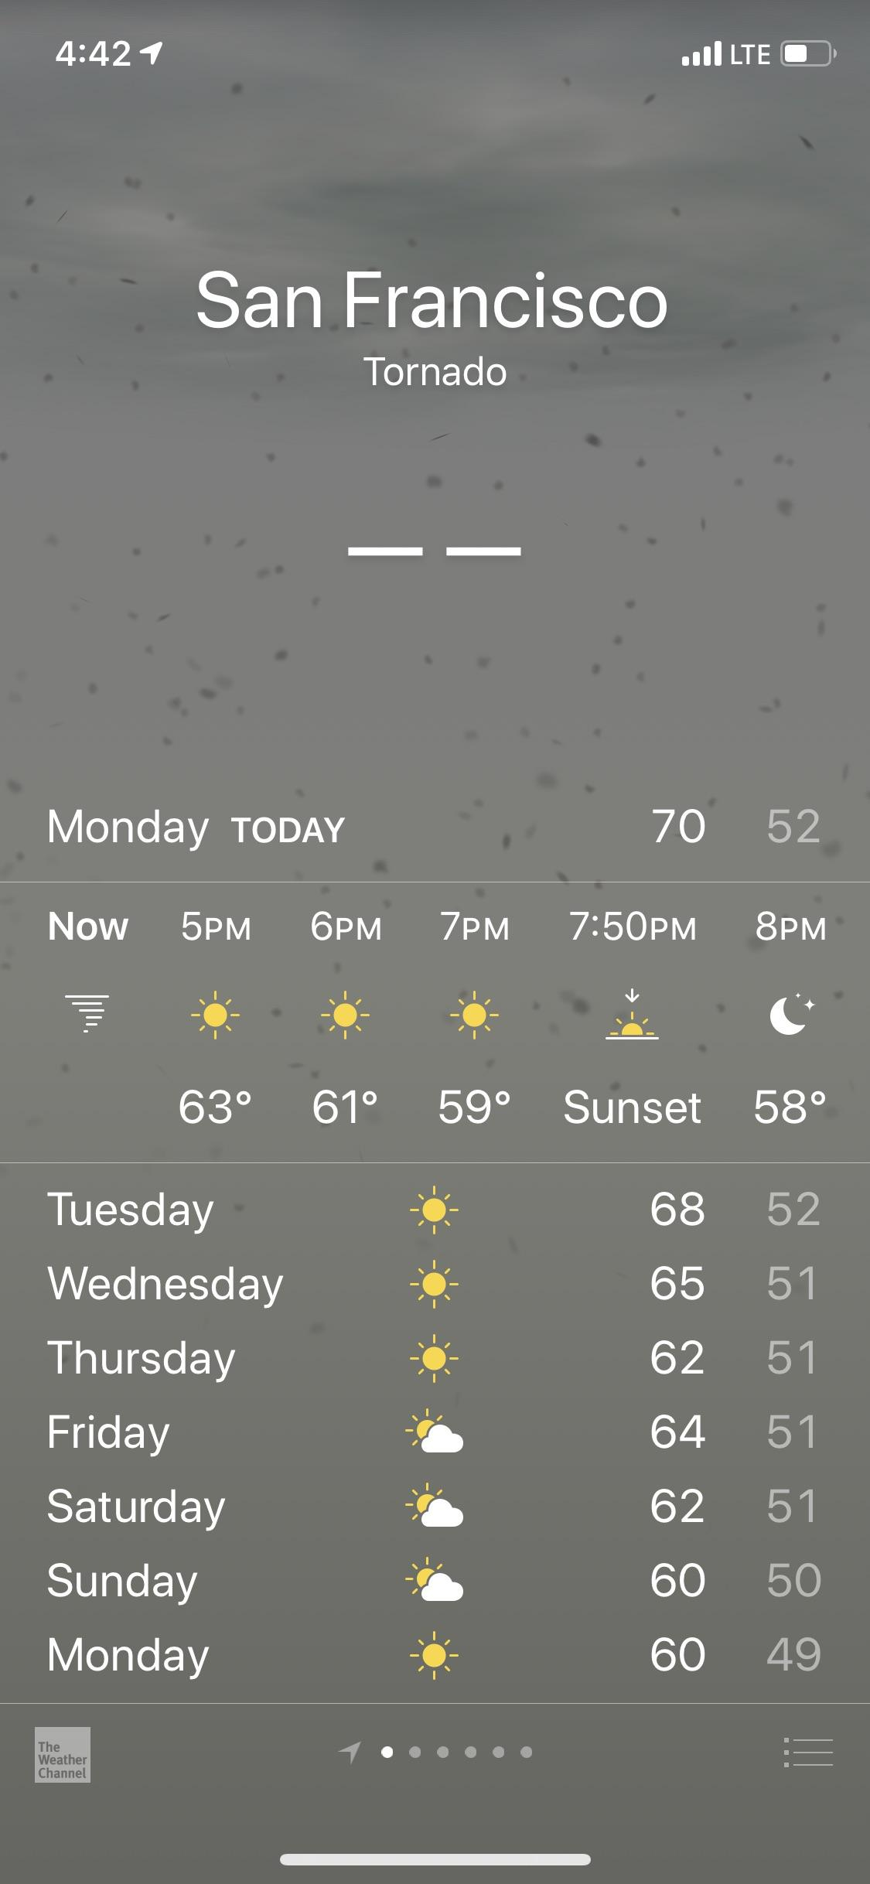
1 – Static Data
2 – Dynamic Data

Slide 5

Request
Servlet
Response

Slide 6
Web Services Characteristics
Exchange of the data happens on the web using HTTP (Http Request, Http Response)
Protocols: REST doesn’t follow any protocol, it can use any format for sending and receiving data.
HTTP Exchange: Any Http method can be used to exchange data.
Service Definition: REST uses no documentation to expose all the details about web service.

Slide 7
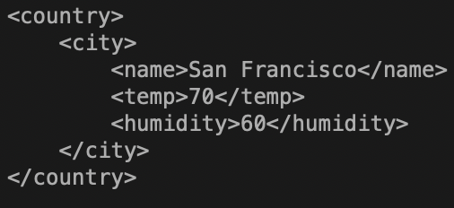
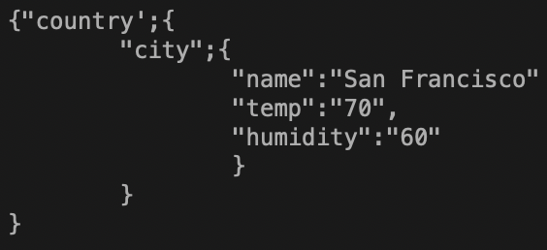
Request
Servlet
Response (html)
Xml/Json

Slide 8

State of the Object
Object

Slide 9
REST
REST is acronym for REpresentational State Transfer. It is architectural style for distributed hypermedia systems and was first presented by Roy Fielding in 2000

Slide 10
More on REST
REST determines how the API looks like. It stands for “Representational State Transfer”. It is a set of rules that developers follow when they create their API. One of these rules states that you should be able to get a piece of data (called a resource) when you link to a specific URL (Uniform Resource Locater) .
Each URL is called a request while the data sent back to you is called a response.
URI and URL:
URI stands for uniform resource identifier and URL stands for uniform resource locator, a URI can be a name, locator, or both for an online resource where a URL is just the locator. URLs are a subset of URIs. That means all URLs are URIs.

Slide 11
REST and HTTP
REST is inspired by a lot of concepts of HTTP, to better understand REST we need to understand some basics of HTTP.

Slide 12
HTTP
HTTP stands for Hyper Text Transfer Protocol
Hyper Test is a structured form of text, it has one common property, it contains logical links between to other text, those links called hyperlink. A common way to write Hyper text is in a language called Hyper Text Markup Language (HTML)
Communication between client computers and web servers is done by sending HTTP Requests and receiving HTTP Responses

Slide 13
HTTP Request / Response
A client (a browser) sends an HTTP request to the web
A web server receives the request
The server runs an application to process the request
The server returns an HTTP response (output) to the browser
The client (the browser) receives the response

Slide 14
Resources:
The key abstraction of information in REST is a resource. Any information that can be named can be a resource: a document or image, a temporal service, a collection of other resources, a non-virtual object (e.g. a person), and so on.
REST uses a URIs to identify the particular resource involved in an interaction between components.
The state of the resource at any particular timestamp is known as resource representation. A representation consists of data, metadata describing the data and hypermedia links which can help the clients in transition to the next desired state.
The data format of a representation is known as a Media Type. The media type identifies a specification that defines how a representation is to be processed.

Slide 15

The Anatomy Of A Request
The Endpoint
The Method
The Header
The Body

Slide 16
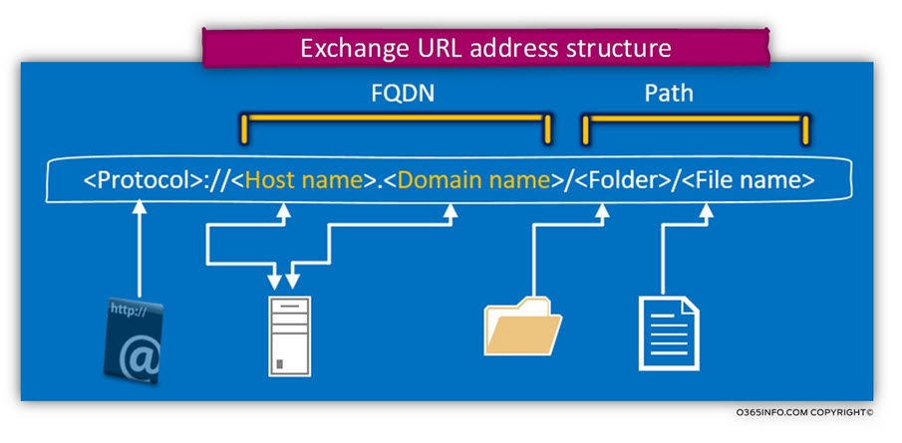
01 – The Endpoint
The endpoint (or route) is the URL you request for. The path determines the resource you’re requesting for.
Resource based and non-resource based endpoints
URL VS Domain:

Slide 17
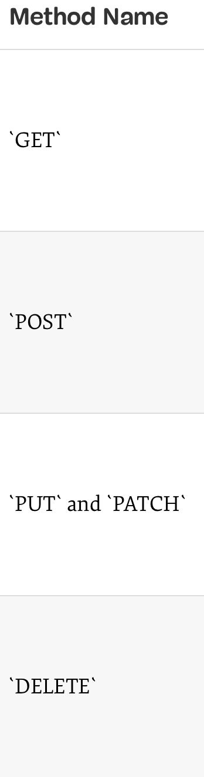
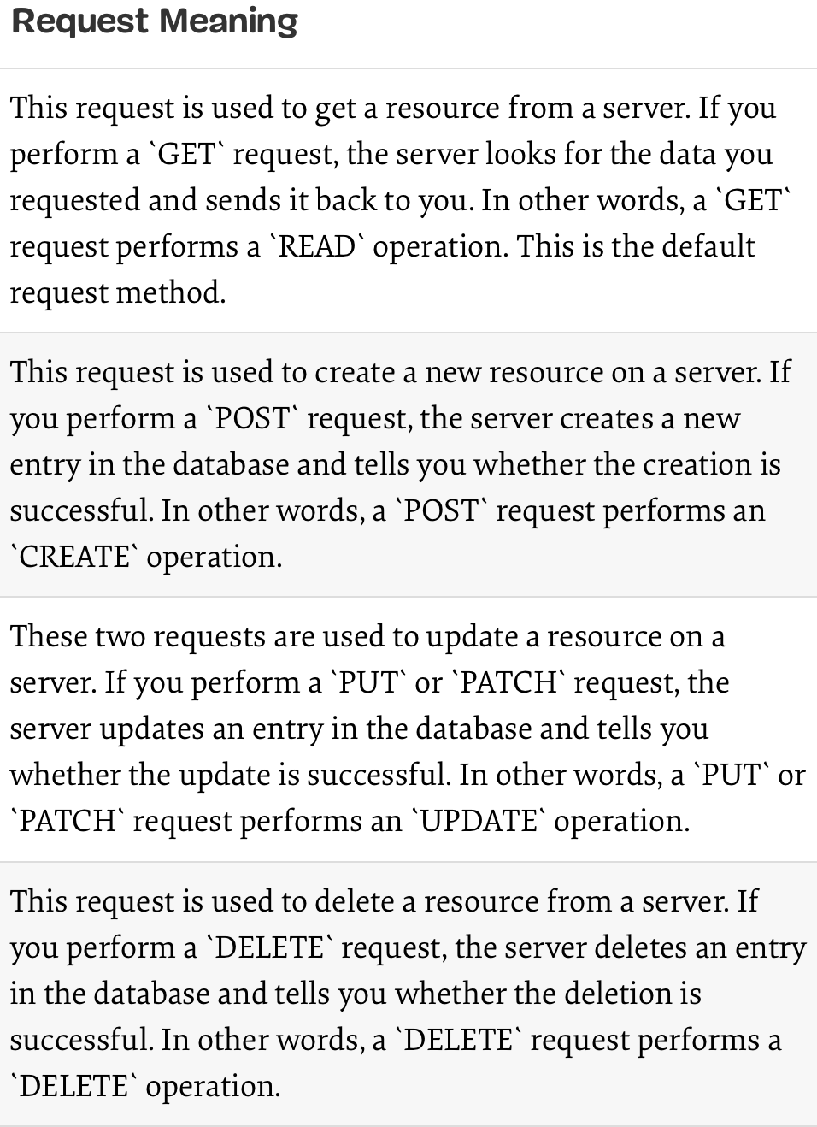
Resources Methods:

Slide 18
More on REST methods
Idempotence:
An operation is idempotent if it produces the same result when called over and over. An identical request should return an identical result when done twice, two thousand, or two million times.
Safety:
An HTTP method is said to be “safe” when it does not alter the state of the server – in other words, a “safe” method is one that functions in a “read-only” mode.

Slide 19
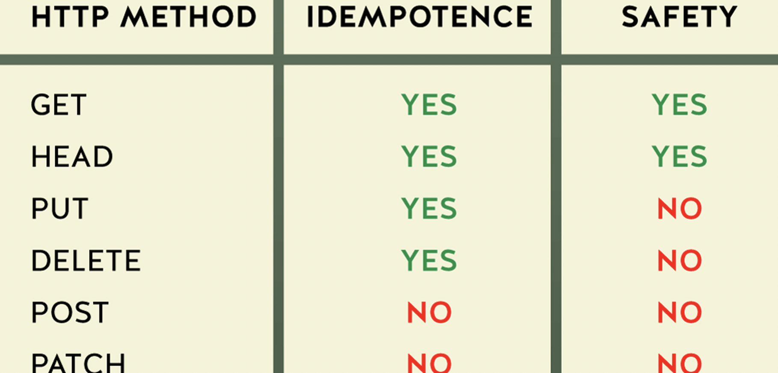

Slide 20
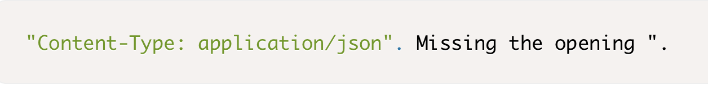
Header
Headers are used to provide information to both the client and server. It can be used for many purposes, such as authentication and providing information about the body content.

Slide 21
The Body (Data)
The data (sometimes called “body” or “message”) contains information you want to be sent to the server. This option is only used with POST, PUT, PATCH or DELETE requests.

Slide 22

HTTP Status Codes And Error Messages
Some of the messages you’ve received earlier, like “Requires authentication” and “Problems parsing JSON” are error messages. They only appear when something is wrong with your request. HTTP status codes let you tell the status of the response quickly. The range from 100+ to 500+

Slide 23
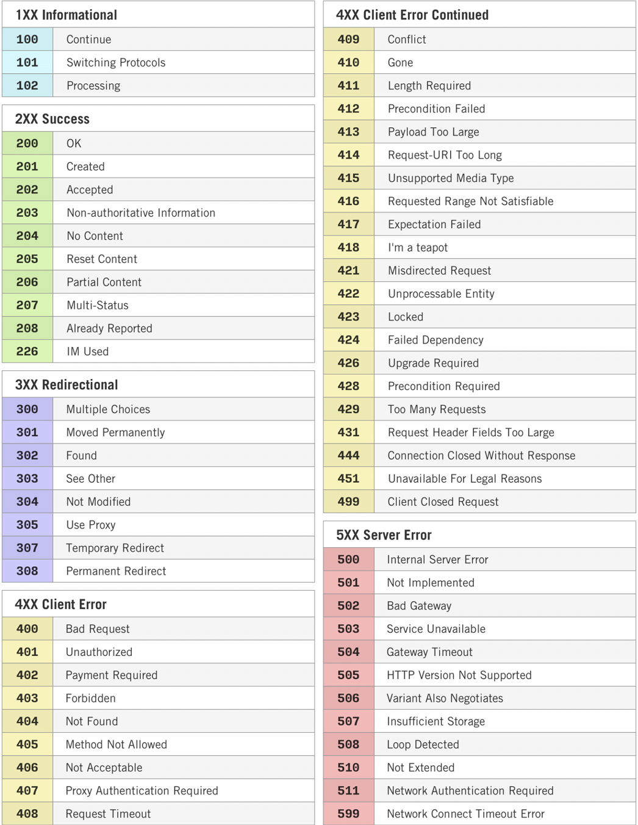
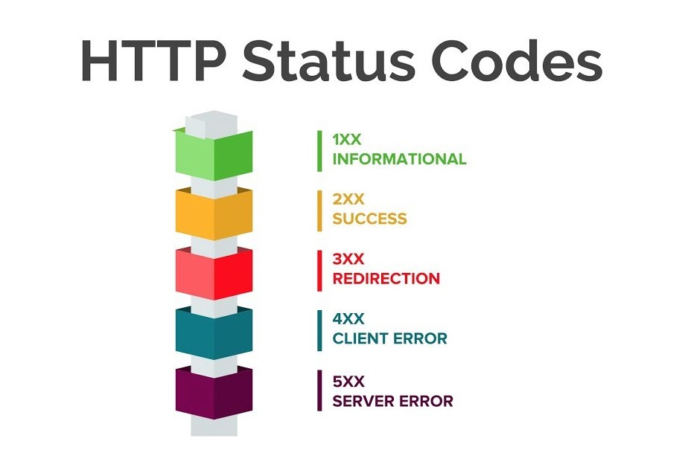

Slide 24
Authentication
With a username and password (also called basic authentication)
With a secret token

